Slide 1
S+U Learning through ANs - Pranjit Kalita
(from paper) Learning from Simulated and Unsupervised Images through Adversarial Training
Ashish Shrivastava, Tomas Pfister, Oncel Tuzel, Josh Susskind, Wenda Wang, Russ Webb
Apple Inc., November 2016

Slide 2
Motivation
Tractability of training models on synthetic images (rather than real ones)
Avoids the need for expensive annotations on real images
Gap between synthetic and real image distributions
Simulated + Unsupervised (S+U) Learning
Improves realism of simulator’s output
Retains annotation information from synthetic images

Slide 3
Basic Framework
Given a simulator S
Assume annotated/labeled synthetic images
Goal :
Improve S’s output through an adversarial net (based on GAN)
Why ?
Reduce human effort in data collection
Preserve annotation/labeling information from synthetic image o/p of S
Computational efficiency for ML algorithms without need to label images manually

Slide 4
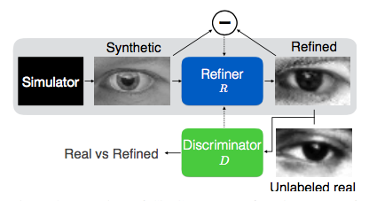
SimGAN – Adversarial Nets for training image samples
Figure 1: Overview of SimGAN
R & D updated alternately

Slide 5
Difference from GANs
Adversarial Network (Generator and Discriminator) similar to GANs
Synthetic images instead of random vectors
Key architectural differences –
Adding a ‘self-regularization’ term
Local adversarial loss
Updating discriminator through history of refined images

Slide 6
Brief overview of GANs
GANs refer to the following minimax game between Generator (G) and Discriminator (D) –

Slide 7
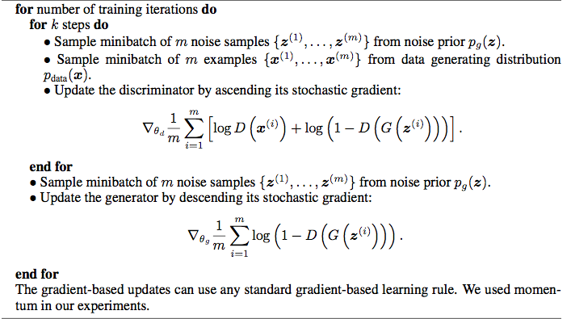
Minibatch SGD training of GANs

Slide 8
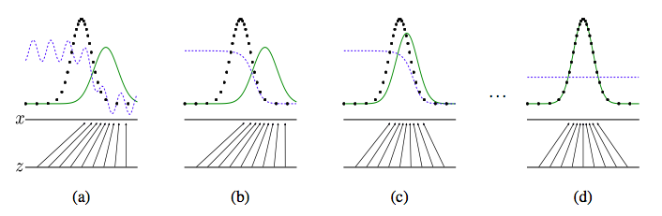
GAN converging steps of p_{g} and p_{data}

Slide 9
Theoretical Results on GAN
Global Optimality of p_{g} = p_{data}
Convergence of SGD GAN algorithm

Slide 10
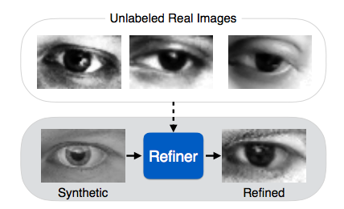
What is S+U Learning?
Figure 2: S+U Learning : The task is to learn a model
that improves the realism of synthetic images from
a simulator using unlabeled real data, while preserving
the annotation information.

Slide 11
Issues with synthetic images for training
Not realistic enough, lack of generalization on real image noise sources
Ex 1: Skin texture, Iris region for gaze estimation
Ex 2: Non-smooth depth boundaries of human for hand-pose estimation not modeled
Improve simulator?
Computationally expensive
Renderer design takes a lot of hard work
Lack of realism may cause models to overfit to ‘unrealistic’ details
Too perfect!

Slide 12
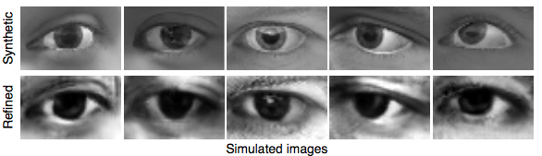
Synthetic simulated vs. Refined simulated I
Figure 3 : Difference between synthetic and refined simulated for eye gaze estimation

Slide 13
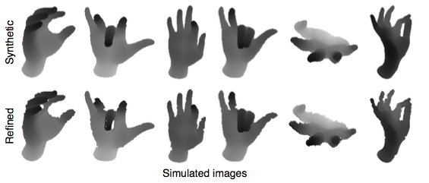
Synthetic simulated vs. Refined simulated II
Figure 4 : Difference between synthetic and refined simulated for hand pose
estimation

Slide 14
Proposed Approach
Goal : Improve realism of simulated images using unlabeled real data (Figure 1).
Improves efficiency by retaining annotation information of synthetic images while removing need for data collection
Ex : Preserve gaze direction in Figure 1
Also ensure images generate without artifacts

Slide 15
SimGAN (improvements over GANs)
Objective : Refines images from simulator using a neural net called ‘Refiner Network ( R )’
Adding realism : R is trained using an adversarial loss, s.t. refined images indisguishable from real ones using another neural net called ‘Discriminator Network ( D )’
Preserving annotations : Adversarial loss complemented with self-regularization loss penalizing large changes between synthetic & refined
Global structure preserved and local adversarial loss protected by operating on a pixel level instead of holistically modifying the image content through a fully connected auto-encoder
GAN framework produces artifacts
Two competing nn’s with competing goals known to be unstable
SimGAN limits the discriminator’s receptive field to local regions
Results in multiple local adversarial losses per image
Stability of Training : D is updated using history of refined images instead of current R

Slide 16


S+U Learning with SimGAN
Refined image is defined by –
Refined image should look like a real image while preserving annotations.
Minimize combination of two losses :
First part adds realism to synthetic images
Second part preserves annotations by minimizing difference between synthetic and refined images

Slide 17

Adversarial Loss with Self-Regularization
Adversarial loss used in training R is responsible for ”fooling” D into classifying refined images as real
Following GAN approach, modeled as a two-player minimax game, and update R and D alternatively
D’s loss function :
First term is probability of input being a synthetic image
Second term probability of being a real one
Implementation :
ConvNet whose last layer outputs the probability of the sample being a refined image
Each mini-batch consists of randomly samples refined synthetic images and real images
SGD step on mini-batch loss gradient

Slide 18

Realism Loss of R used by D
Objective is to minimize this loss function
Refiner forces the Discriminator to classify refined images as real
Part of the min of the minimax game between G & D of GAN

Slide 19

How to preserve annotations?
In addition to generate realistic images, annotations of synthetic images must be preserved
This is where the self-regularization term comes in
Ex : hand pose estimation in the location of joints should not change in refined, gaze direction in gaze estimation (we will see this in results section)
The overall loss function for the refiner is –

Slide 20
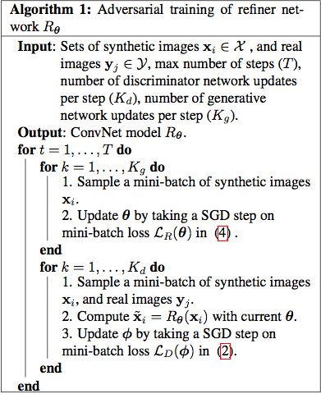
Algorithm of SimGAN

Slide 21
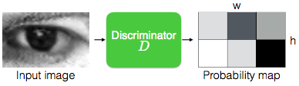
Local Adversarial Loss
Does not introduce artifacts
While training D, R tends to over-emphasize certain image features to fool D
This leads to drifting and creating artifacts
Local patch sampled from the refined image should have similar stats to real image patch
Thus, D classifies all local image patches separately
Limits receptive field
Many samples per image for learning D
Improves training of R due to multiple ‘realism loss’

Slide 22
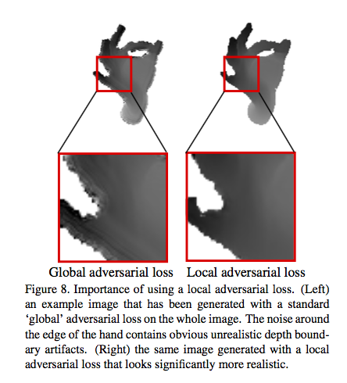
Local Adversarial Loss in Hand Pose Estimation

Slide 23
Update D using a history of refined images
Problems with training D only with refined images –
Diverging of adversarial training
R might re-introduce forgotten artifacts
Proposed method –
Update D using history of refined images, instead of the ones in the current batch
Algorithm modified to have buffer of refined images generated by previous networks
If B is size of buffer and b is mini-batch size in Algorithm
For each iteration of D, computer loss by sampling b/2 images from current R, and b/2 from the buffer to update parameters for D’s loss function

Slide 24
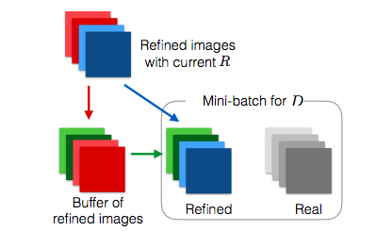
Illustration of using history of refined images
Figure 3: Using history of refined images from previous refined and current R (note the division)

Slide 25
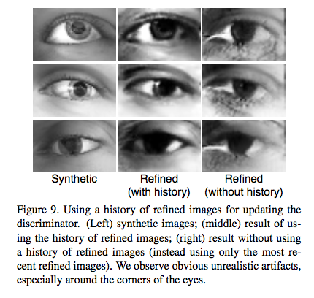
History of Refined Images in Eye Gaze Estimation

Slide 26
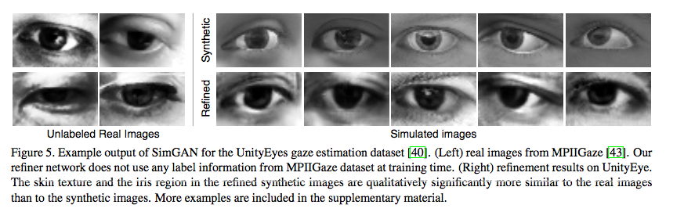
Experimental Results on Eye Gaze Estimation
Qualitative Results

Slide 27
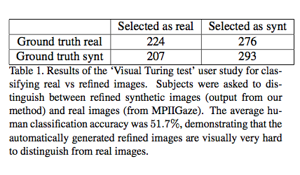
Visual Turing Test Results

Slide 28
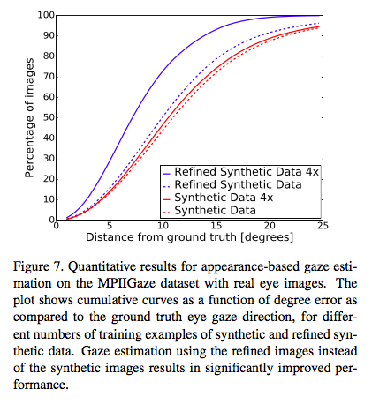
Quantitative Results of Eye Gaze Estimation

Slide 29
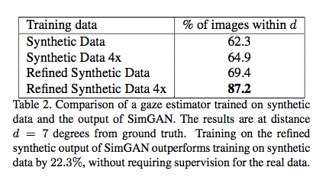
Comparison of SimGAN on different training data sources

Slide 30
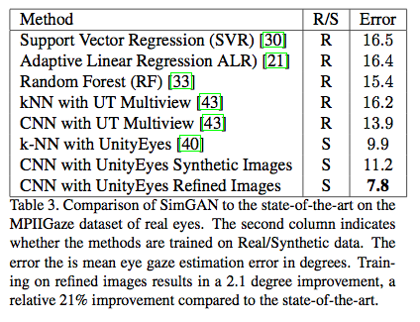
Comparison of SimGAN to state-of-the-art

Slide 31
In the future…
Investigate refined videos
Model noise distribution to generate multiple refined images for each synthetic image

Slide 32
The End.
Thank you for your attendance.

